Slide 1


Slide 2

MICROSOFT POWERPOINT

Slide 3
WHAT IS A MICROSOFT POWERPOINT
Microsoft PowerPoint is a powerful slide show presentation program.
Microsoft PowerPoint is a software application that is particularly used to present data and information by using text, diagrams with animation, images, and transitional effects etc in the form of slides.
You will learn more about this in upcoming slides.

Slide 4
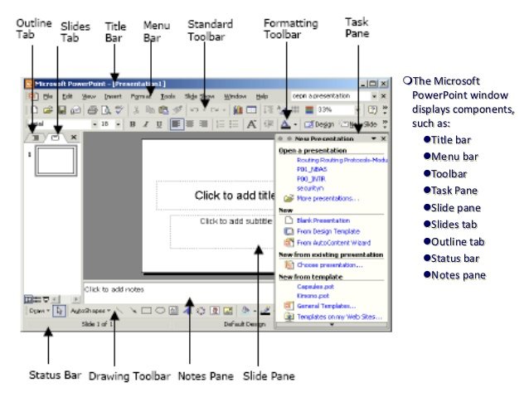

Slide 5
01
Creating PowerPoint Presentation

Slide 6
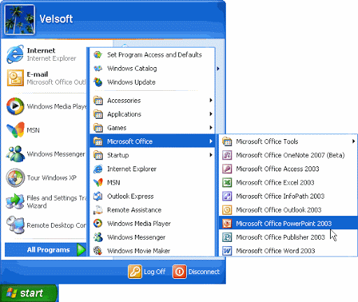
Steps for Powerpoint Presentation:
Microsoft office Powerpoint
Go to start
All Programs
Microsoft office

Slide 7

Steps to Add the slides : Go to home
New slides
Click on slide type You want
Add the slide

Slide 8
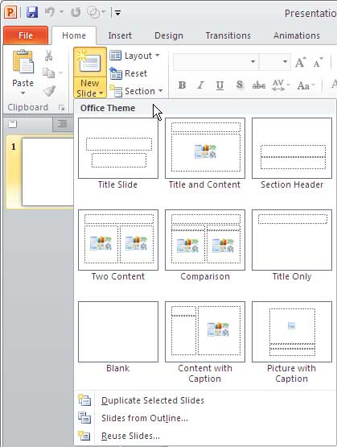


Slide 9

Steps to Delete slide : Click on slide from Slides menu from left side Column
Right click on mouse
Delete the slide

Slide 10
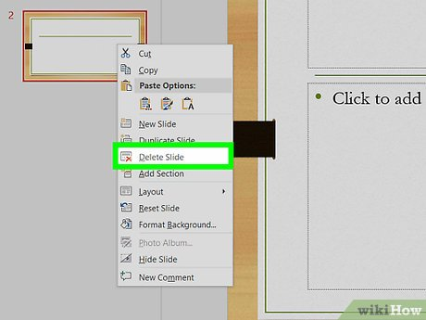


Slide 11
Steps to design page : Go to design
Select Dropdown menu of theme
Added your theme

Slide 12
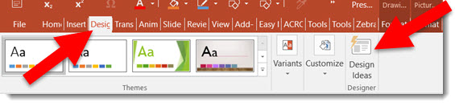

Slide 13

Steps to slideshow: Go to Slideshow
Click on Beginning
Slide show

Slide 14
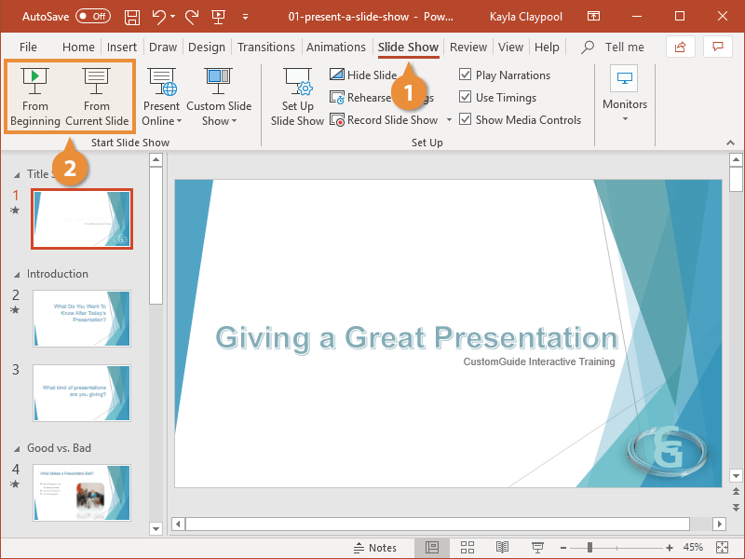

Slide 15

Steps to Save document: Go to File
Save as
Save the name
Select folder to save
Save

Slide 16
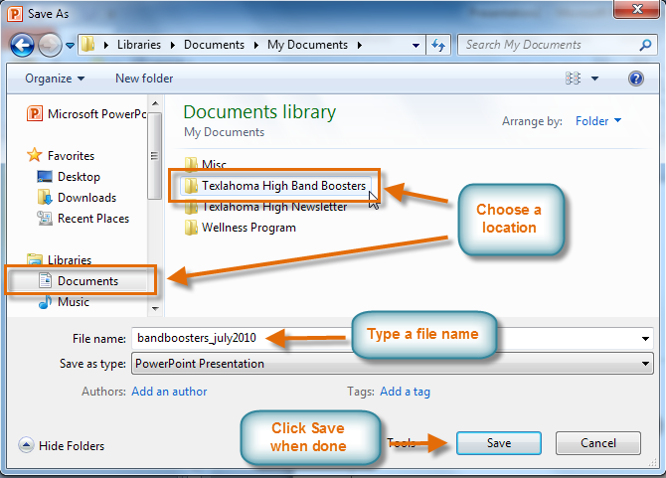
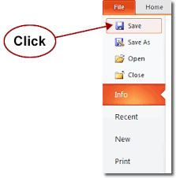

Slide 17
Steps to Add the text box : Go to Insert
Text box
Drag pointer on screen
Added text box

Slide 18
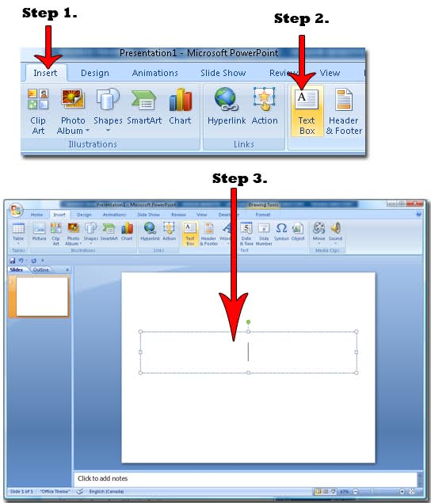

Slide 19
Steps to Add Table : Go to Insert
Table
Click on number of row and columns
Add number of rows and columns
Or
Click on Insert table
Table Added

Slide 20
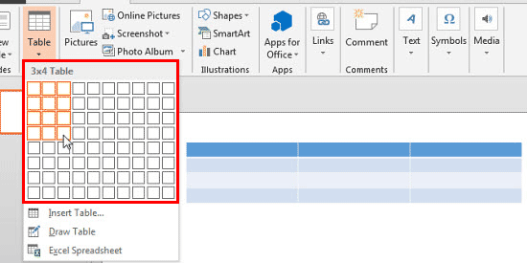

Slide 21
Steps to Add the word art : Select the word
Go to Insert
Choose the art you like
Added Word art

Slide 22
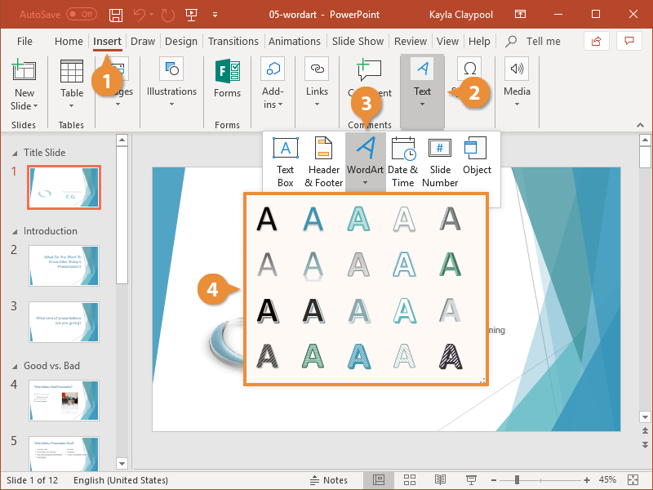

Slide 23
Steps to add transitions: Go to transitions
Click on Transition slide you want
Apply the effect

Slide 24
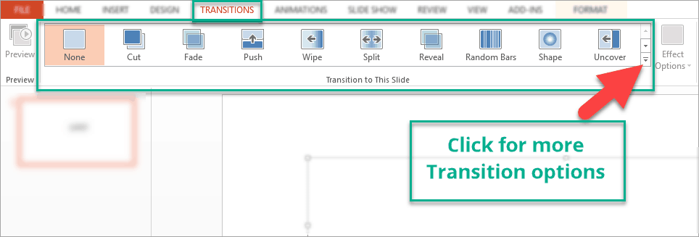

Slide 25
Thank-you

